Slide 1
Experimental and numerical study on size effects in Nanoindentation
Presenter: B.Sc. Yao Yao
Supervisors: Univ. Prof. Dr.-Ing. Sebastian Münstermann
Dr. Ude Hangen
M.Sc. Michael Dölz
M.Sc. Wenqi Liu

Slide 2
Outline
Introduction
Material
Experimental results and discussion
Load-displacement curves
Indentation size effects
Surface topography
Numerical results and discussion
Parameterization
Validation of parameters
Formulation
Conclusions & outlooks

Slide 3
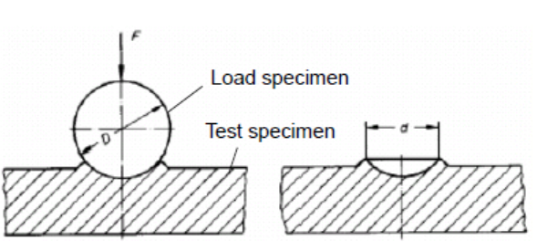
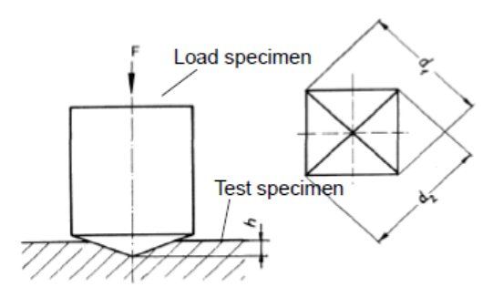
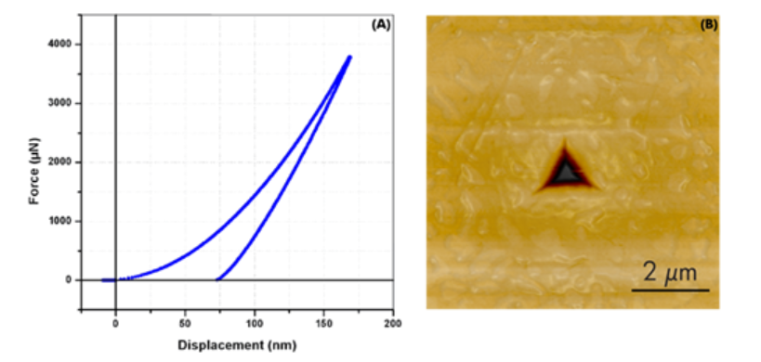
Introduction - Nanoindentation
Macro Indentation
Brinell
Vickers
* IEHK, Lecture slides
Nanoindentation
* Bruker, Introduction of nanoindentation

Slide 4

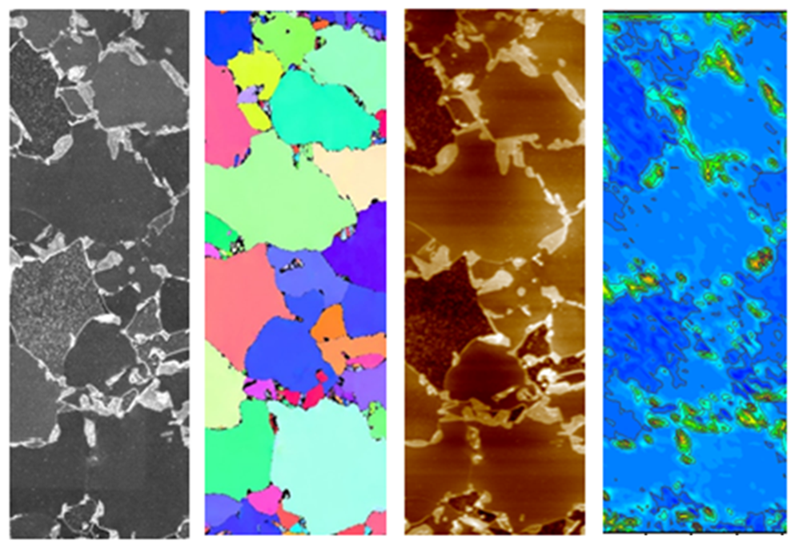
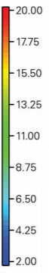
Introduction – Nanoindentation Application
Mechnical properties distribution with nanoindentation
GPa
DP600 Steel
Comparison of hardness maps
with microscopy maps
Hardness difference between
ferrite and martensite
* Bruker, Brochure

Slide 5
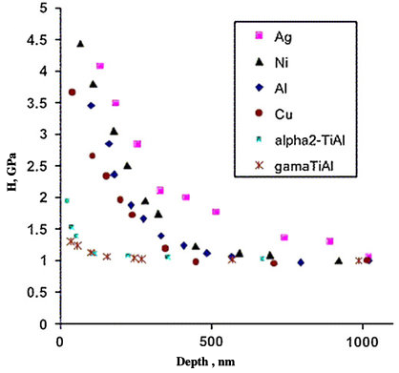
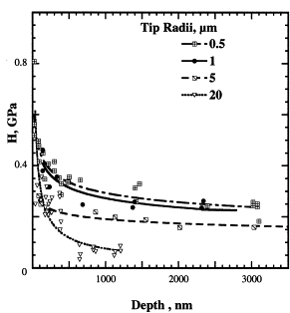
Introduction – Indentation size effect (ISE)
Smaller is stronger in indentation:
Conical/Pyramid Indenter：
Spherical Indenter：
* Chang Qing Sun, Relaxation of the Chemical Bond, 2014
* Tymiak, Acta Materialia, 2001
Notes:
traditional material design: heat treatment, mechanical tests, component test to identify the distance between designed and targeted material properties. trial and error
massively spends material, time, energy, and money
Aim: to develop a simulation toolkit for the computer-assisted material design
Toolkit flow
advantages
in order to achieve the whole circle of the toolkit approach, the information flow between multiscale should be build up using a reference material.
Today, my topic is mainly focused on the transition from component level to macroscopic mechanical property profile.

Slide 6
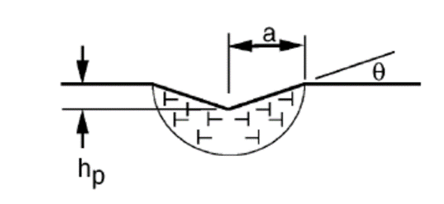
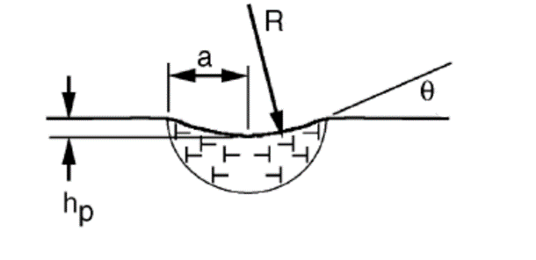
Introduction – Indentation size effect (ISE)
Plasticity strain gradient / Geometrically necessary dislocation (GND)
* Swadener, Journal of the Mechanics and Physics of Solids, 2002

Slide 7
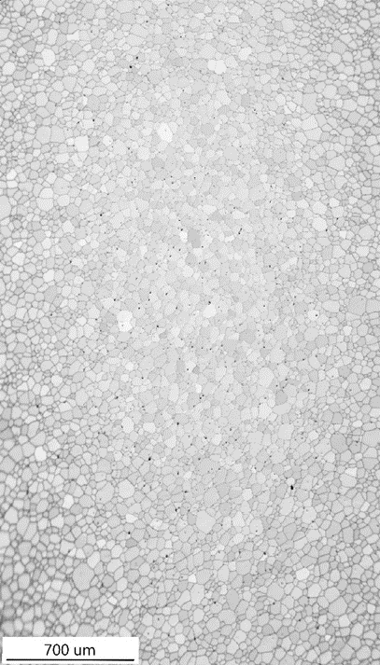
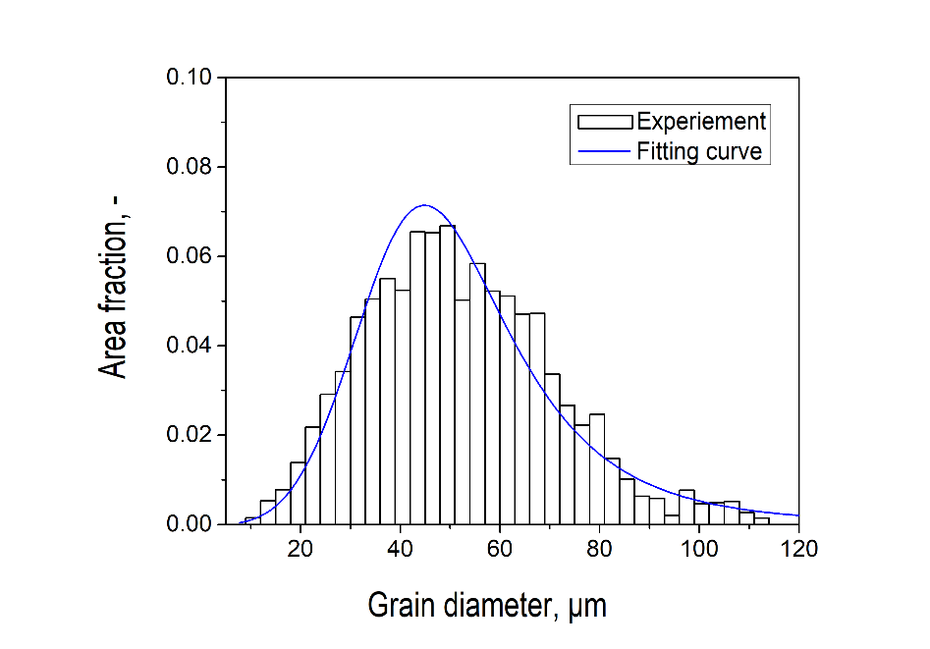
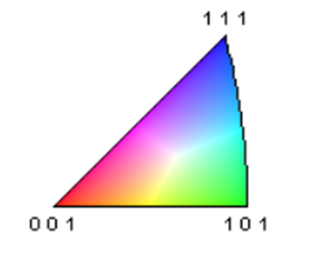

Material
Microstructure
AISI 439: a cold-rolled ferritic stainless steel
Composed of ferrite and small volume of carbides
Average grain diameter： 54 μm

Slide 8
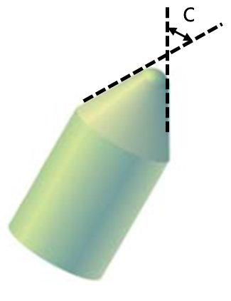
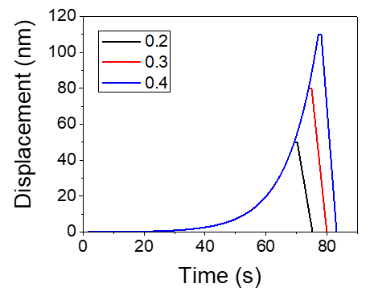
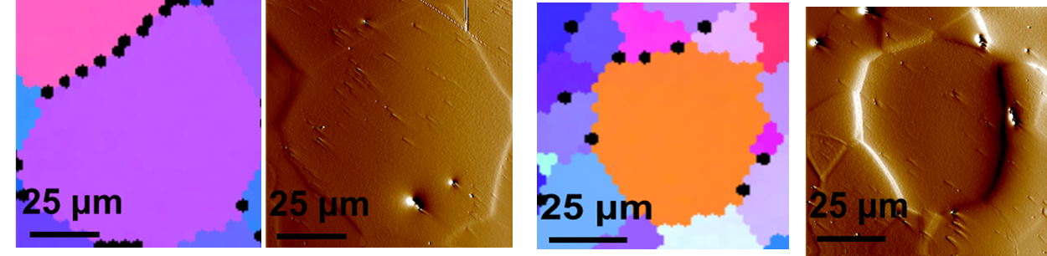
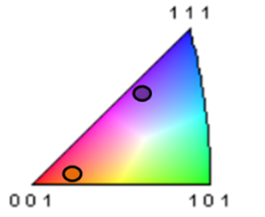
Experiment setup
Indenter radius
1 μm
2 μm
5 μm
20 μm
a/R
0.2
0.3
0.4
a/R: Indentation strain (a: contact radius, R: indenter radius)
Constant stain rate of 0.1 s⁻¹
{111} grain
{100} grain

Slide 9
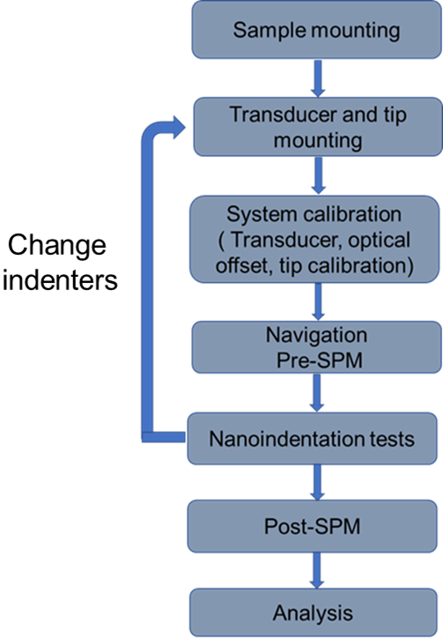
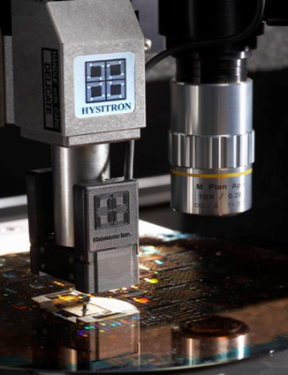
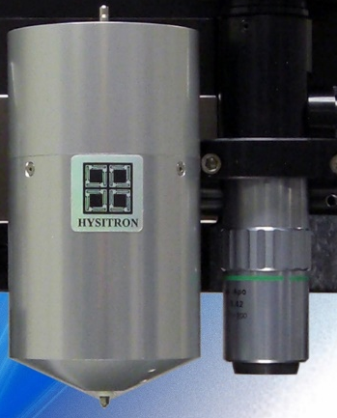
Experiment setup
Post SPM is performed to find the location of to
find tested grains.
Calibration of system every time when changing
Indenters.
Post imaging after test to obtain surface topography
1&2 μm indenter
5&20 μm indenter

Slide 10
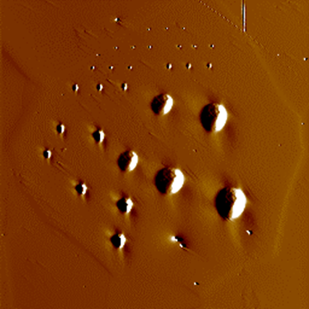
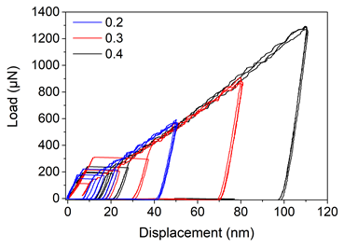
Experiment results and discussion
Load-displacement curves of {111} grain with 1 μm indenter

Slide 11
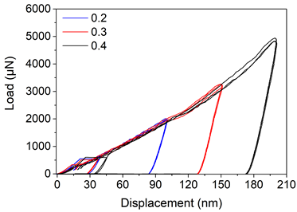
Experiment results and discussion
Load-displacement curves of {111} grain with 2 μm indenter

Slide 12
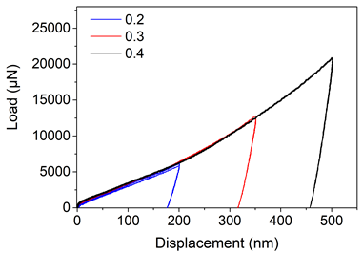
Experiment results and discussion
Load-displacement curves of {111} grain with 5 μm indenter

Slide 13
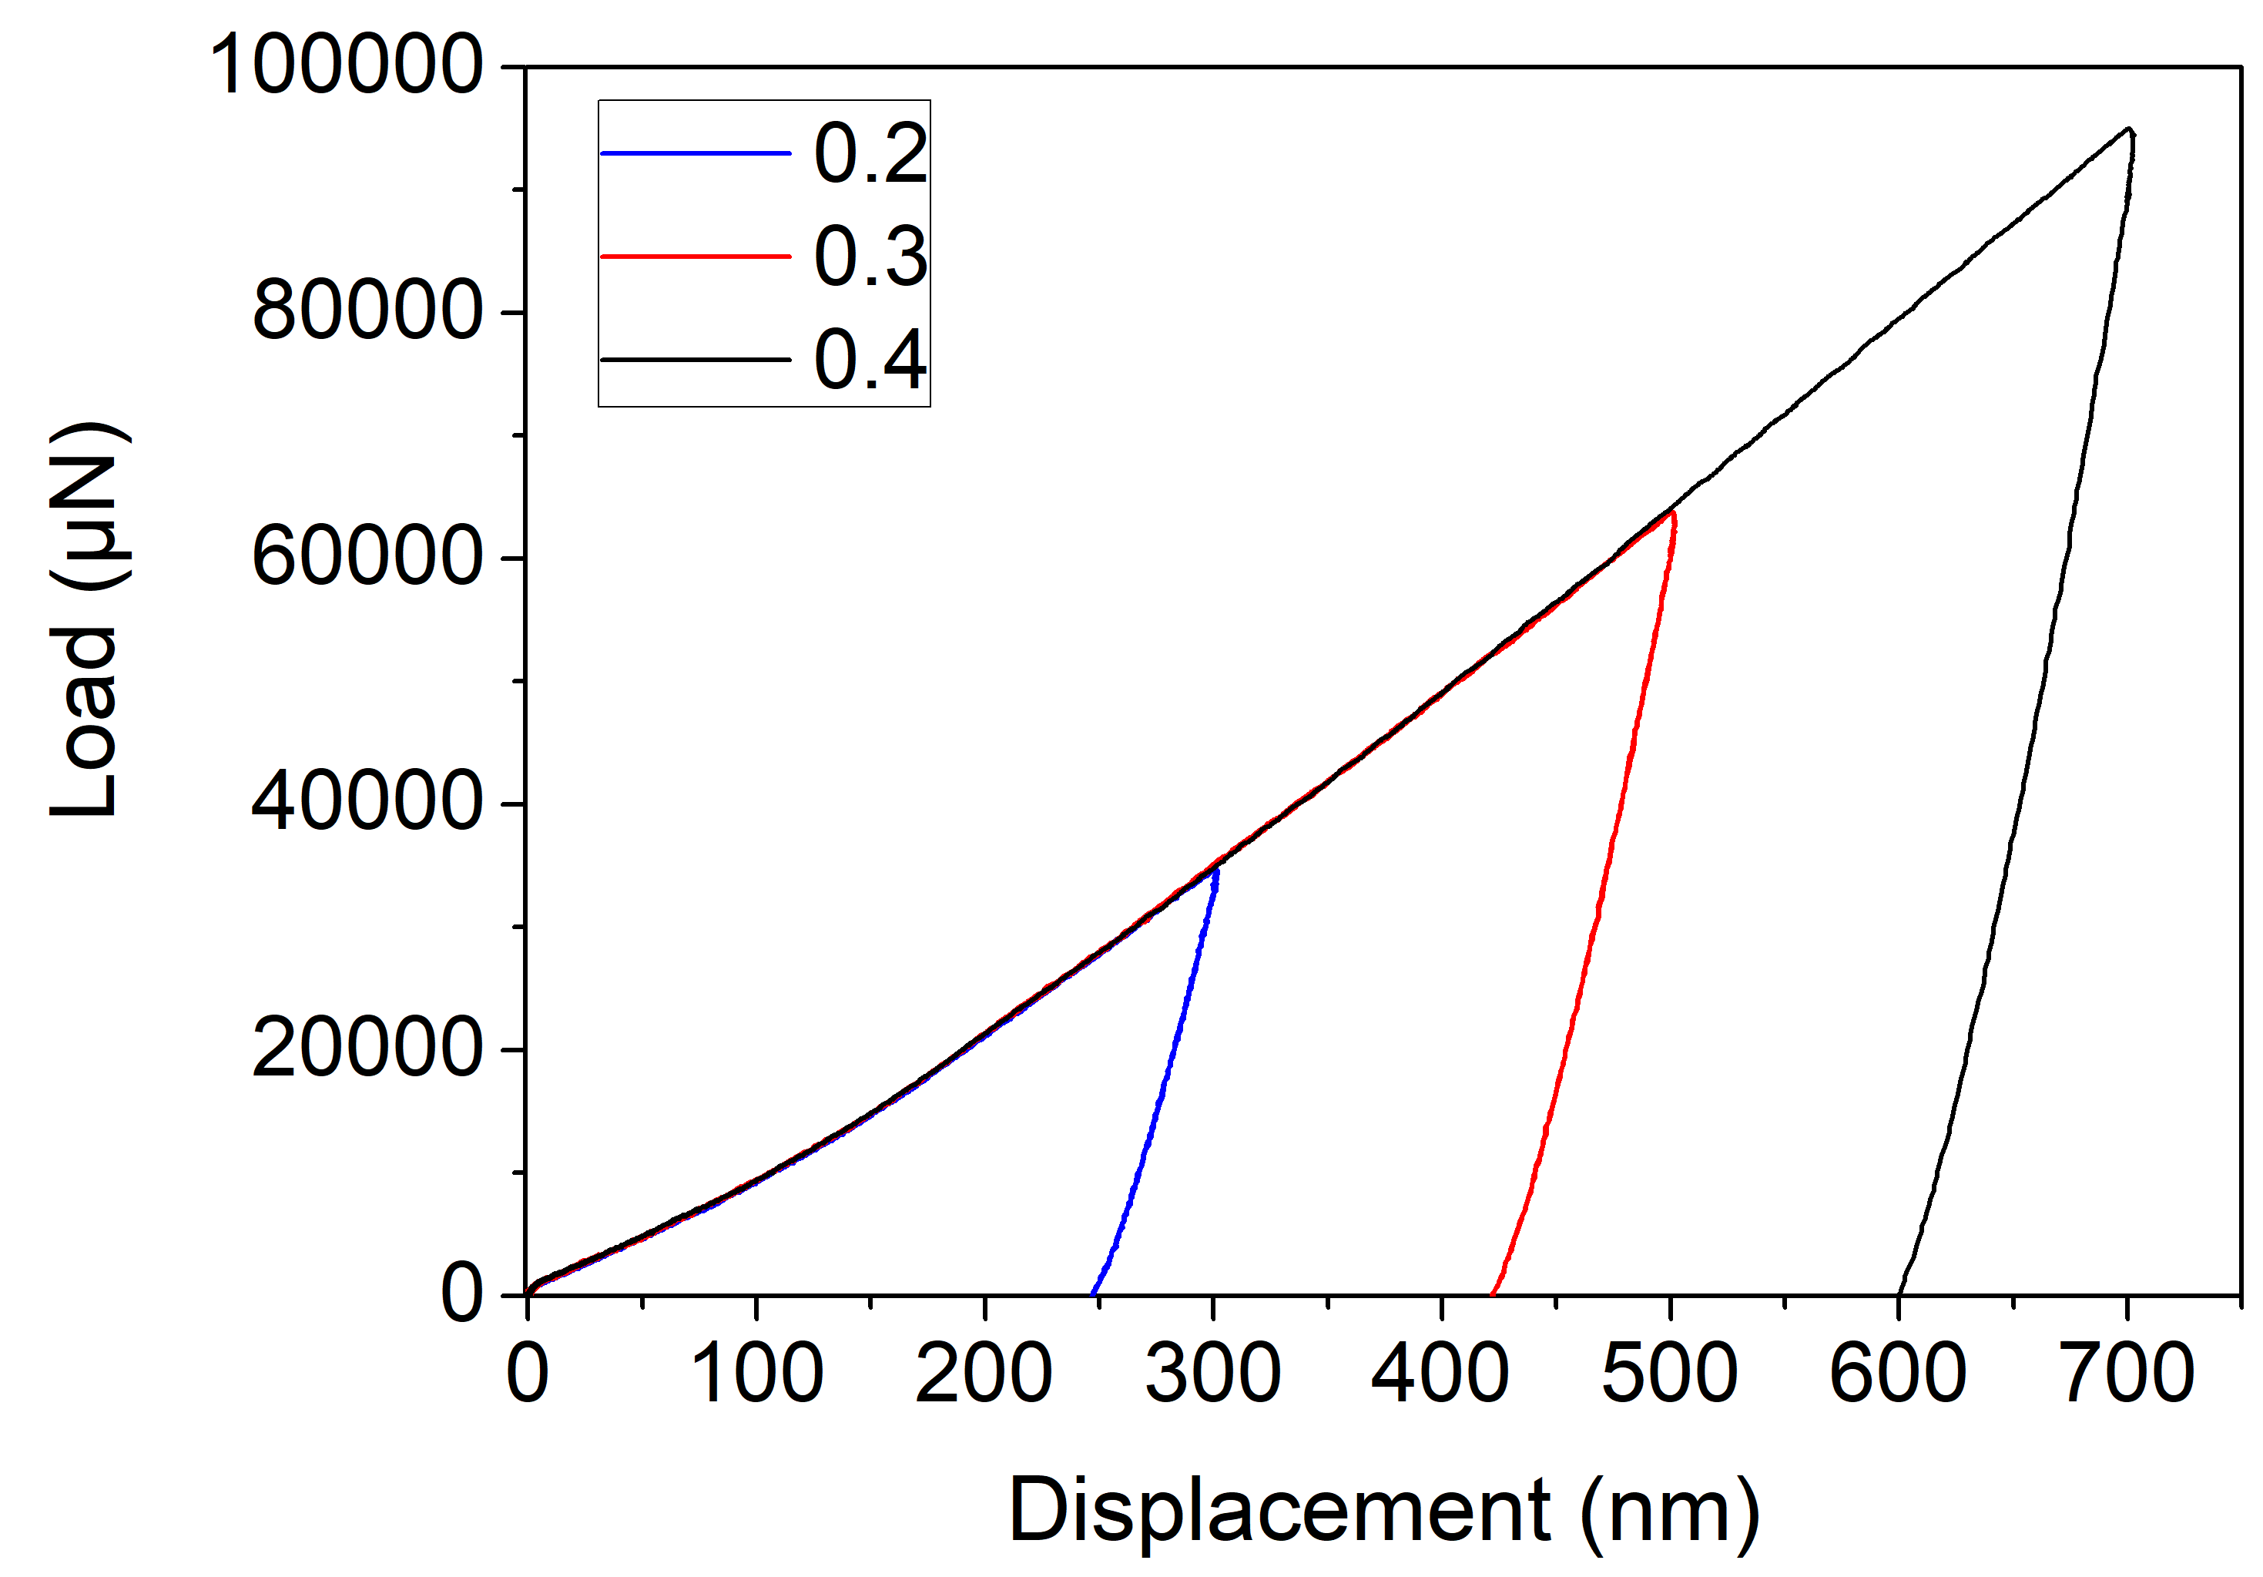
Experiment results and discussion
Load-displacement curves of {111} grain with 20 μm indenter

Slide 14
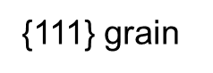
Experiment results and discussion
Prominent size effect can be observed:
The hardness increases with smaller
Indenter radius
Slight decrease of hardness with increasing contact depth for the same indenter

Slide 15
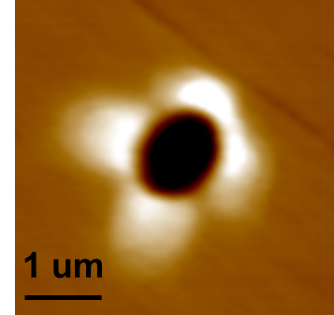
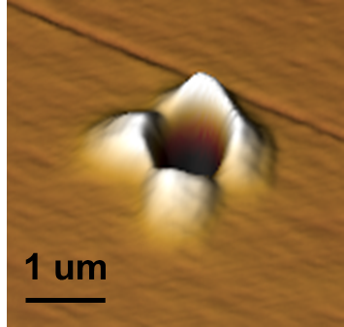

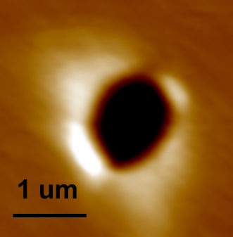
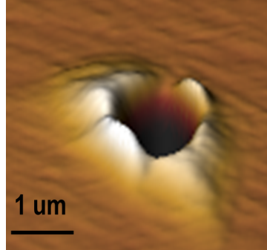
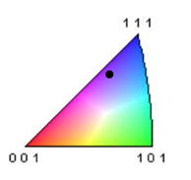
Experiment results and discussion
Surface topography and pile-up patterns
1 um indenter 0.4 strain
{100} grain
1 um indenter 0.4 strain
{111} grain
* Xiaoxue Liu, Master thesis

Slide 16
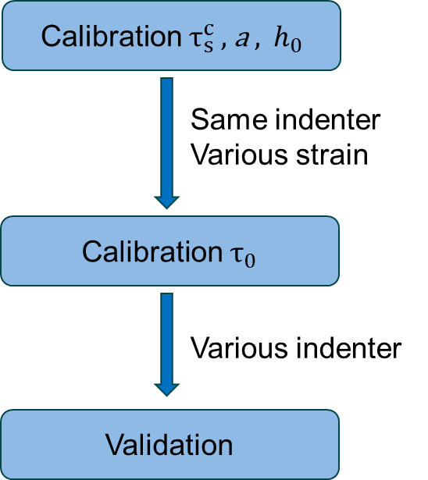
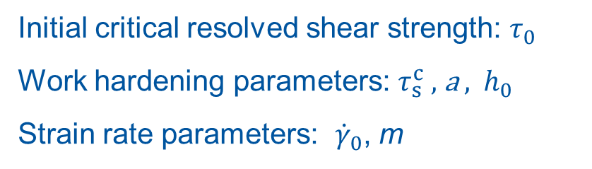
Numerical setup
Crystal plasticity model:
Dislocation slip based formulations
Initial critical resolved shear strength: $τ_{0}$
Work hardening parameters: $τ_{s}^{c}$ , a , $h_{0}$
Strain rate parameters: ${\dot{γ}}_{0}$, m

Slide 17
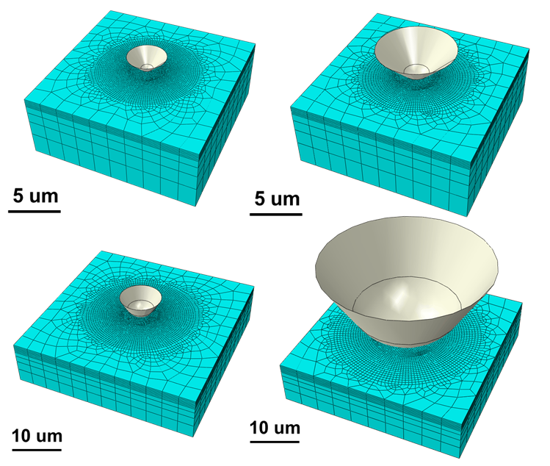
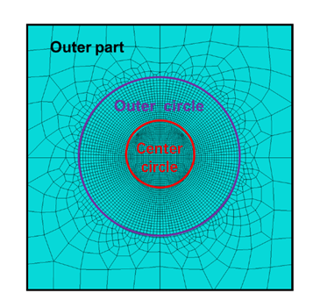
Numerical setup
Nanoindentation models:
Indenter | Total size (μm³) | Diameter of center circle (μm) | Mesh size of center circle (μm)
1 | 20×20×8 | 4 | 0.1
2 | 20×20×8 | 5 | 0.125
5 | 60×60×15 | 12 | 0.3
20 | 60×60×15 | 24 | 0.6

Slide 18
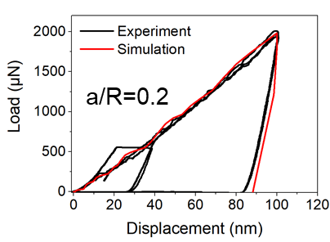
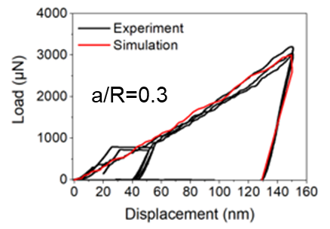
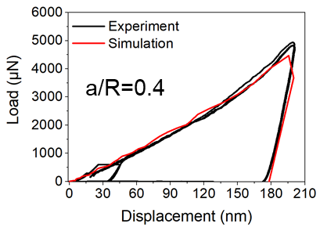
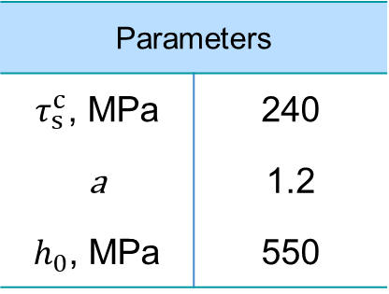
Numerical results and discussion
Calibration of work hardening parameters:
Parameters
$τ_{s}^{c}$, MPa | 240
a | 1.2
$h_{0}$, MPa | 550

Slide 19
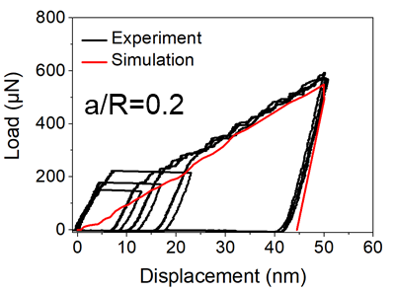
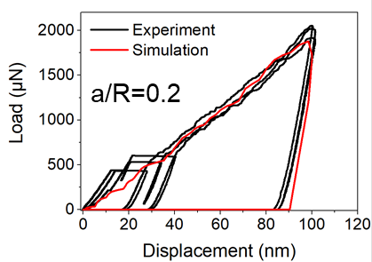
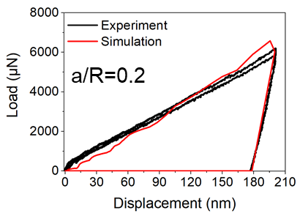
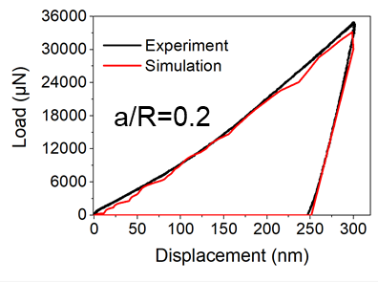
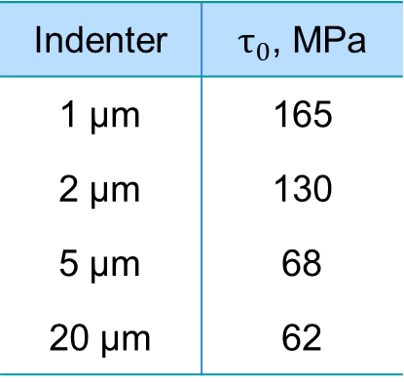
Numerical results and discussion
Calibration of $τ_{0}$:
2 μm
1 μm
Indenter | $τ_{0}$, MPa
1 μm | 165
2 μm | 130
5 μm | 68
20 μm | 62
5 μm
20 μm

Slide 20
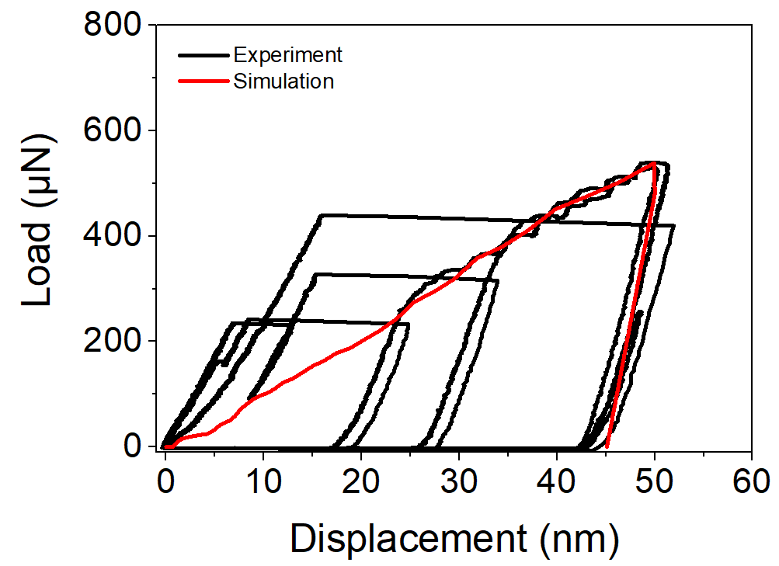
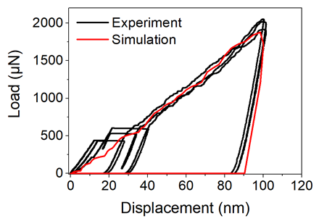
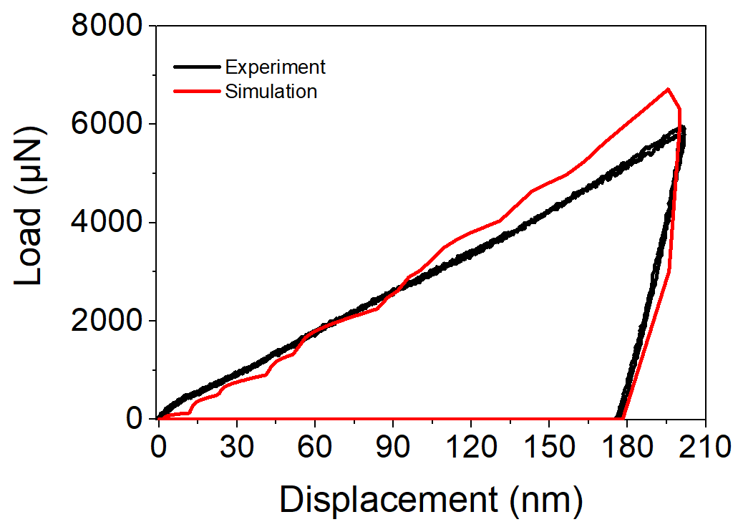
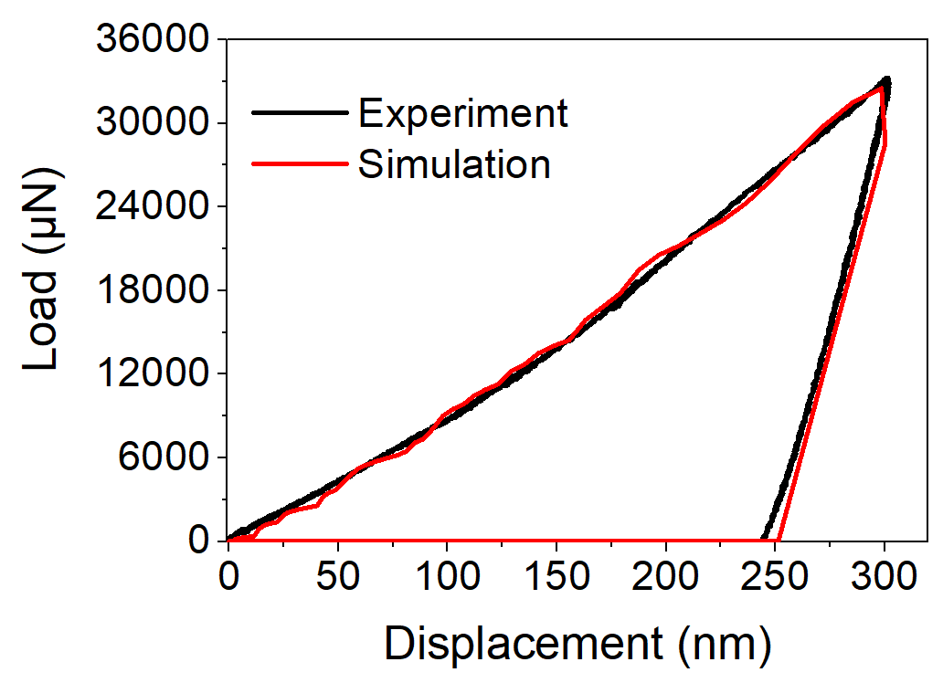
Numerical results and discussion
Validation of calibrated parameters in {100} grain at 0.2 strain
1 μm
2 μm
5 μm
20 μm

Slide 21
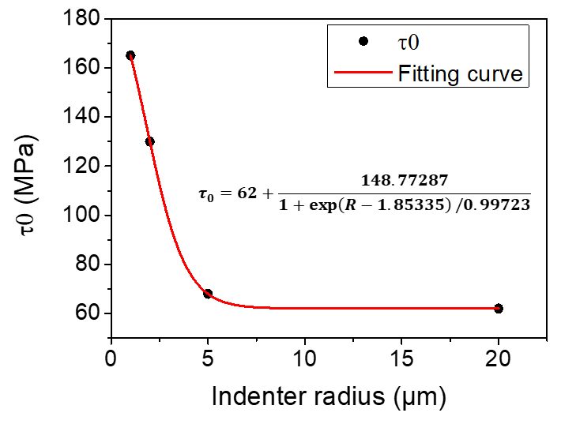
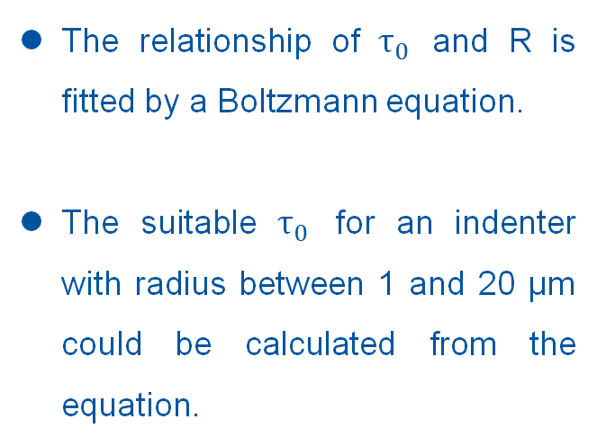
Numerical results and discussion
The relationship of $τ_{0}$ and R is fitted by a Boltzmann equation.
The suitable $τ_{0}$ for an indenter with radius between 1 and 20 μm could be calculated from the equation.

Slide 22
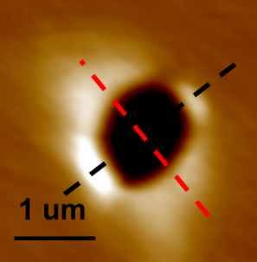




Numerical results and discussion
SPM
Simulation
P-H
1 um indenter
0.4 strain
{111} grain
1 um indenter
0.4 strain
{100} grain

Slide 23

Conclusions and outlook
Experiments on AISI 439
Size effect is observed when varying indenter radius;
The hardness decrease with increasing depth for the same indenter;
The hardness and pile-up are orientation dependent.
Numerical study with CPFEM
The size effect is well captured by varying $τ_{0}$ ;
The relationship between $τ_{0}$ and R is given by a Boltzmann equation.
Outlook
The calibrated parameters should be incorporated into a mesoscale model.
Nanoindentation with another indenter radius should be performed to validate the expression.
Non-local CP model should be used for further study.

